Slide 1
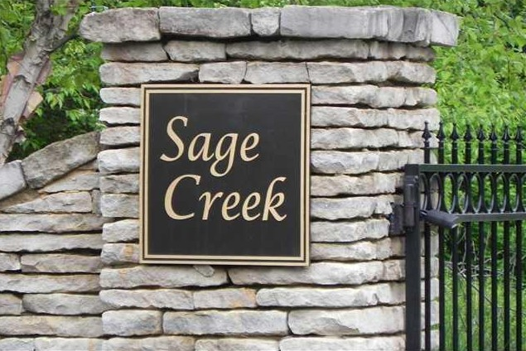
Sage Creek HOA
2025 Annual Meeting
Nov 12, 2025

Slide 2
Agenda
Introductions
Guest Speaker – Jeffrey Dittmer Sage Creek Attorney
FY25 Financial Review and 2026 Budget
Committee Reports
Road Project Update
Galena and Surrounding Area Update
Reminders on community help and assistance
General Discussion
Adjournment

Slide 3
Introductions
Current Board Members
President – Dennis Johnson
Vice President – Rich Sobota
Vice President – Cade Wagner
Treasurer – Kevin Flynn
Secretary – Mary Scheibal
Committees
Beautification Committee – Karen McCann, Sue Bunting, Jacqueline Sellers
Road Committee – Scott Liston, Rich Sobota, Rob Smith
Welcoming Committee – Sue Bunting, Shiela Rao-Lasota
Design Review Committee – Rich Sobota, Candace Baker, Kevin Murray
Social Committee – Jennifer Johnson, Darlene Rupp
Gate Operations – Cade Wagner

Slide 4
Agenda
Introductions
Guest Speaker – Jeffrey Dittmer Sage Creek Attorney
FY25 Financial Review and 2026 Budget
Committee Reports
Road Project Update
Galena and Surrounding Area Update
Reminders on community help and assistance
General Discussion
Adjournment

Slide 5
Jeffrey Dittmer (Attorney) – Guest Speaker
Topics
Introduction – Jeffrey Dittmer: Dittmer, Wagoner, and Steele, LLC.
Deed Restriction Clarifications

Slide 6
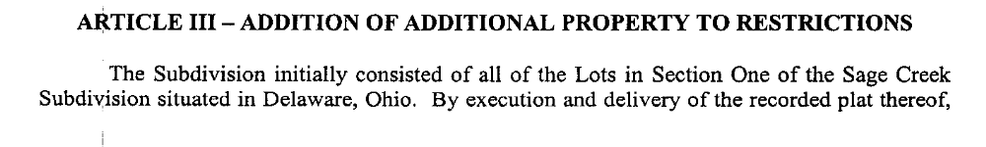
Jeffrey Dittmer – Deed Restriction Clarifications
Background: Sage Creek was developed in several sections with one set of Deed Restrictions for all Sections.
Article III of the First Amendment to Restrictions, Covenants, Conditions, and Agreements Controlling the Use of Lots Located in Sage Creek Subdivision , Delaware County, Ohio of record in Official Record 582, Page 422 is instructive:

Slide 7
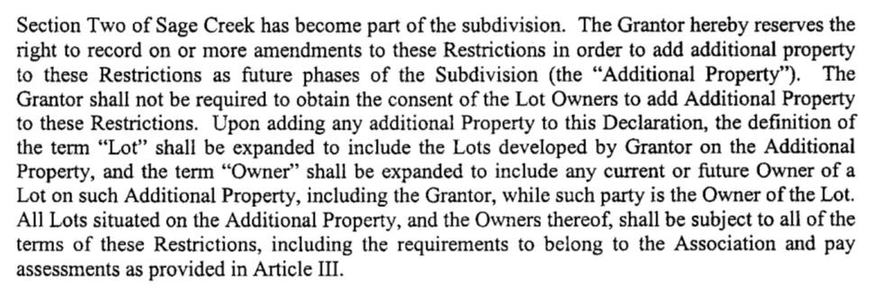
Jeffrey Dittmer – Deed Restriction Clarifications (2)
Accordingly, ALL Lot Owners in Sage Creek belong to the association and are governed subject to the Deed Restrictions and Design Guidelines.
The HOA must necessarily enforce the governing documents including but not limited to the Deed Restrictions and Design Guidelines as to ALL Lot Owners in Sage Creek.

Slide 8
Agenda
Introductions
Guest Speaker – Jeffrey Dittmer Sage Creek Attorney
FY25 Financial Review and 2026 Budget
Committee Reports
Road Project Update
Galena and Surrounding Area Update
Reminders on community help and assistance
General Discussion
Adjournment

Slide 9
FY25 Financial Summary
Financials
Revenue: Revenue for 2025 was $64,641 (includes both Operating & Road Funds)
Expenses: Expenses to date are $52,673 (reduced from Q3 due to $9,510 insurance reimbursement)
Expense Variance: Expenses were $17,263 above plan as follows:
  Snow Removal: +$5,680
  Legal: +$9,173 (Reduction from Q3 report due to insurance reimbursement)
  Gate Repair: +$1,131
  Other: +$1,123 (Other puts/takes account for the additional $1K)
For reference, 2024 expenses were +$24.6K over budget.
Next year’s budget we’ll use our past average expenses with a few exceptions.

Slide 10
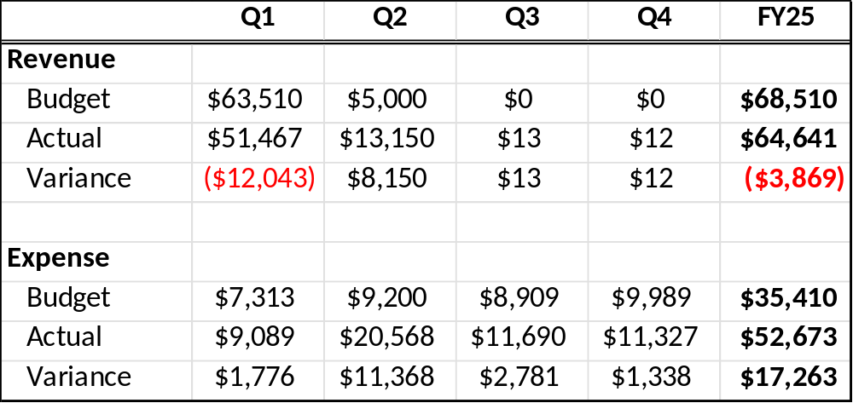
FY25 Financial Summary
Financials
Table of prior slide
Income slightly less due to greater CD income in prior year
Expense overages:
  Snow: $5,680
  Legal: $9,173
  Gate: $1,131
  Other: $1,279

Slide 11
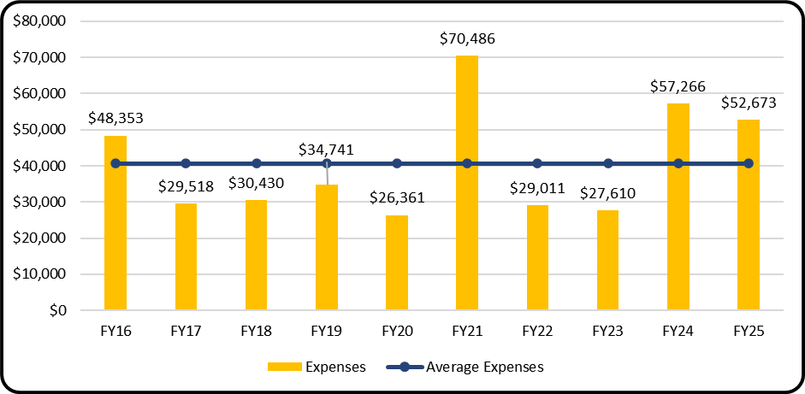
FY25 Financial Summary
Financials
10Y Average Expenses shown below (Avg = $40,645)
+$19K
Gate Repair
+17.2K
(Snow, Legal, Gate)
+$15K
Road Expense
+$32K
Road Expense
10Y Average Expense: $40,645

Slide 12
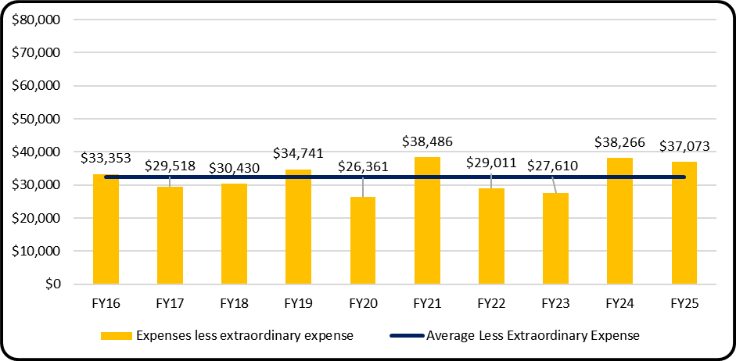
FY25 Financial Summary
Financials
10Y Average Expenses excluding the “extraordinary” expenses (Avg = $32,485)
14.1% above 10y average
3.1% below 2024 expenses
11.1% above 2016 expenses
CPI = 5.3%
CPI = 8.5%
10Y Average = $32,485

Slide 13
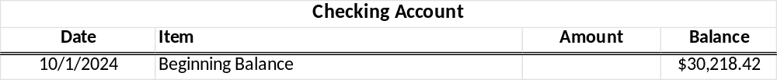
Balance Sheet Info
Checking Account (Operating Funds)
Important Notes
Income items for Dues include both Operating Fund and Road Fund.
Operating Fund (Checking Acct) owes Road Fund (Savings Acct) $27,797 for 2025 Road Fund.

Slide 14

Balance Sheet Info
Savings Account (Road Fund)
Important Notes
(Recall this account is “owed” $27,797 from the Checking Acct. (Shown above → $15K + $12,797)

Slide 15
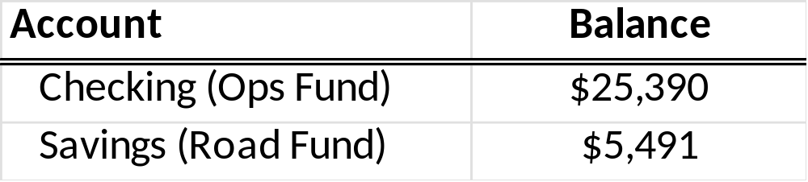
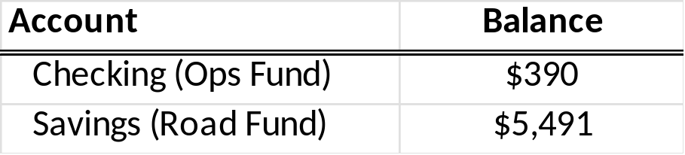
Balance Sheet Info
Summary of Current Cash Positions as of 10/28 (Operating Fund + Road Fund)
Would be near $0 in Ops Fund w/out loan
Important Notes
Balances include $25K Loan to HOA (Total cash position would be less than $6K.)
Totals don’t include expenses past 10/28 or so.
  Since then, we’ve had: Fall Cleanup (Reichle), Pond Winterization, Annual HOA Insurance, Electric, Cell, Gate Repair, etc.
  We’ve averaged $6.3K for Q1 expenses ranging from 5K – $9K. (i.e. we needed contingency)
  Other risk mitigation step taken was sending Annual Dues bill early and encouraging early pmt.

Slide 16
2026 Dues & Assessment
Reminder regarding FY26 Payments for Dues and One-Time Assessment
Due Date Item Amount
12/15/25 HOA Operating Annual Dues $600.00
12/15/25 HOA Road Fund Annual Dues $600.00
2/1/26 Road Paving Assessment Pmt#1 $475.00
3/1/26 Road Paving Assessment Pmt#2 $475.00
Total: $2,150.00
Important Notes
Many residents have already made payments, thank you!
Early payments are encouraged and appreciated.

Slide 17
Agenda
Introductions
Guest Speaker – Jeffrey Dittmer Sage Creek Attorney
FY25 Financial Review and 2026 Budget
Committee Reports
Road Project Update
Galena and Surrounding Area Update
Reminders on community help and assistance
General Discussion
Adjournment

Slide 18
Beautification Committee
Committee Responsibilities
Manage start up/shut down of irrigation system and pond, monitor landscaping within the common areas, contract snow removal and liaison with those associated vendors to ensure quality of work.
Spring/Summer
Clean up and order plants for Sunbury Rd entrance. New vendor is Hoover Gardens. $1,312.97
Hydrotech to open irrigation system at Sunbury Rd entrance. $172.00
SOLitude Lake to treat pond for algae and reinstall pond pump. $1,372.17
Midwest Lightscapes to ensure lights at both gates are working. $100.00
Reichle Brothers to maintain lawncare of common area (spring clean-up, pruning and mulch; mowing, insect/weed control, fertilizer applications). $10,733.88
Oversee general landscape maintenance for front and rear gates.

Slide 19
Beautification Committee
Fall
Hydrotech to winterize irrigation system. $110
SOLitude Lake to winterize pond pump.
Weed, prune and remove spent flowers.
Reichle Brothers to complete fall leaf removal and perennial maintenance.
Winter
Holiday decorating.
Snow removal (2025): $11,680.00
Beautification Committee Contacts:
Karen McCann: kpmccann369@gmail.com
Sue Bunting: csbunting@aol.com

Slide 20
Welcome Committee
Committee Responsibilities
Meet and greet new homeowners
Provide Welcome Info to new residents
Maintain and update the Residential Directory
Answer questions regarding our community
Welcome Committee Contacts:
Sue Bunting: csbunting@aol.com
Shiela Rao-Lasota: shielarao@hotmail.com

Slide 21
Welcome to Sage Creek Community
New Sage Creek Residents, 2025
Tony and Lucy Tanner: 9921 Sage Creek Drive
Allen and Holly Albrecht: 10606 Sage Creek Drive
Welcome Committee Contacts:
Sue Bunting: csbunting@aol.com
Shiela Rao-Lasota: shielarao@hotmail.com

Slide 22
Social Committee
2025 Highlights:
What a fun year! We loved learning the not-so-easy game of Mahjong with 12 neighbors. Huge thanks to Darlene Rupp for hosting those great classes.
Our Fall Tailgate brought together nearly a third of the neighborhood for diverse food and a lot of fun. A big thank you to all the helpers with setup/takedown (especially Chuck….sorry about your shoulder!).
What's Next?
Based on tailgate sign-ups, we're looking to start groups for Euchre, Walking, Yoga, and Game Nights! Got another idea? Send it our way!
Save the Date: April 12, 2026. We're organizing a group to walk the Ohio State 4 Miler to support the Buckeye Cruise for Cancer. Interested in joining our team? Please contact Darlene or Jennifer.
Social Committee Contacts:
Darlene Rupp: darrupp28@gmail.com
Jennifer Johnson: Tajjohnson30@gmail.com

Slide 23
Design Review Committee
“Spring Clean-up” Request Communication was Successful
  Property maintenance throughout the community is excellent!
  We live in a community we can all be very proud of!
10+ DRC Project Requests Reviewed/ Approved
  Two (2) Building extensions approved & wrapping up
Please contact the DRC for your future plans as specified in the Sage Creek Community Design Guide and/or the Deed Restrictions, Article II, Section 2
  DRC always available to assist in your project planning
Home & Property Maintenance without changes does not require DRC approval
Contact: sage_creek_homeowners@yahoo.com to discuss plans or if you would like to join the committee

Slide 24
Design Review Committee – Review Requirements
For a Design Review submission – see pages # 27-30 of the Sage Creek DESIGN GUIDE, which provide details on what is required for DRC review & approval:
  Description of the Project
  Description of Materials and Colors to be used
  Project Schedule
  Architectural, Landscaping Drawings, and a plot map (from Delaware County Auditor's website) with areas marked with improvements
  Planned subcontractors, names, addresses, phone numbers
  Building Permits (if required)

Slide 25
Design Review Committee – Design Guide Update
Design Guide Update (Candace Baker, Kevin & Laura Murray)
Reviewing potential DRC Guideline Updates
  House Colors & Materials
  Other?
Email will be sent documenting these in more detail
Design Review Committee Contacts:
Rich Sobota: rasobota@gmail.com
Laura Murray: murray.laura@gmail.com
Candace Baker: ccknapp7@hotmail.com

Slide 26
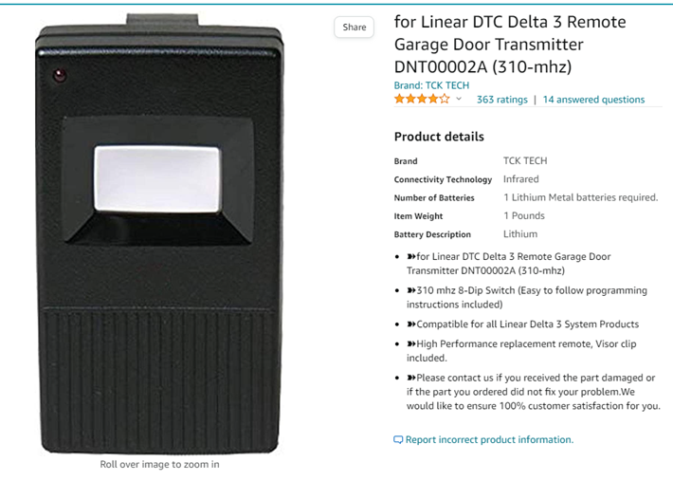
Gate Operations Update
Gate Programming (How to add a remote)
Replacement remotes can be found on Amazon (see below)
  To set the code (DIP Settings:)
    1=OFF
    2=ON
    3=OFF
    4=OFF
    5=OFF
    6=ON
    7=OFF
    8=OFF
Some modern cars also have “Homelink”
See your auto manual to program your car to open the gate by cloning the code from the remote.

Slide 27
Gate Operations Update
Gate Maintenance Updates
Blacktop was overlayed OVER the sensor wires and has a much cleaner look than the previous patched cuts
Front Gate
  Quarterly maintenance schedule is helping reliability
  Working as expected
Back gate is currently experiencing issues with remotes
  Has had a few maintenance calls for issues
  Working as expected

Slide 28
Agenda
Introductions
Guest Speaker – Jeffrey Dittmer Sage Creek Attorney
FY25 Financial Review and 2026 Budget
Committee Reports
Road Project Update
Galena and Surrounding Area Update
Reminders on community help and assistance
General Discussion
Adjournment

Slide 29
Road Project Update
Repaved entire community in one single phase for $360k (15%+ discount) & down from $442K in prior “split” contract.
  Commercial Grade 2.5” compacted ODOT #448 asphalt
  Should last 20 years; maintenance not expected until 8-10 yrs depending on wear & tear
  PaveOH under 1-year warranty; punch list items have been noted
Board received 25+ communications from HOA community expressing overall satisfaction
Upgraded overall community appearance – PaveOH also repaved 10+ driveways & 1 CAD
Estimates to shore-up edges in-process from PaveOH, Reichle Bros and Trent Grove Landscaping. Plan to start with entrances and intersections.

Slide 30
Expected Costs (from last year’s meeting)
Taking a look back
2023 Quote by Premier Asphalt, the following:
SEAL COATING entire neighborhood:
One coat squeegee as requested. One coat spray.
Total: $54,250
CRACK FILL: Up to 35,000 LF
Total: $18,500
Complete Resurfacing (2” OVERLAY):
Entire neighborhood (approximately 205,000 square feet)
Total: $442,000
(Quote from Ethan – Premier Asphalt)

Slide 31
Agenda
Introductions
Guest Speaker – Jeffrey Dittmer Sage Creek Attorney
FY25 Financial Review and 2026 Budget
Committee Reports
Road Project Update
Galena and Surrounding Area Update
Reminders on community help and assistance
General Discussion
Adjournment

Slide 32
Galena & Surrounding Area Update
Galena Updates: (From conversation with Mayor Jeff Kinnell)
Lots of Annexation (Sunbury) going on to our North and East
Galena wants to remain “very residential friendly”
Miller Farms will be a phased multi-year development
Pedestrian Traffic Improvement have been completed in Galena Square
Rumble strips and speed bumps are now installed in Galena
New Boardwalk over Hoover may be starting construction
New sewer line is to be built along Trenton Road (by Galena)
Sage Creek could possibly tie into the new line, if enough residents were interested to make it cost effective.

Slide 33
Agenda
Introductions
Guest Speaker – Jeffrey Dittmer Sage Creek Attorney
FY25 Financial Review and 2026 Budget
Committee Reports
Road Project Update
Galena and Surrounding Area Update
Reminders on community help and assistance
General Discussion
Adjournment

Slide 34
Agenda
Introductions
Guest Speaker – Jeffrey Dittmer Sage Creek Attorney
FY25 Financial Review and 2026 Budget
Committee Reports
Road Project Update
Galena and Surrounding Area Update
Reminders on community help and assistance
General Discussion
Adjournment

Slide 35

General Discussion
I dream of volunteering for a Committee or being on the Board!

Slide 36
Agenda
Introductions
Guest Speaker – Jeffrey Dittmer Sage Creek Attorney
FY25 Financial Review and 2026 Budget
Committee Reports
Road Project Update
Galena and Surrounding Area Update
Reminders on community help and assistance
General Discussion
Adjournment

Slide 37


Thank You!!!

Slide 38
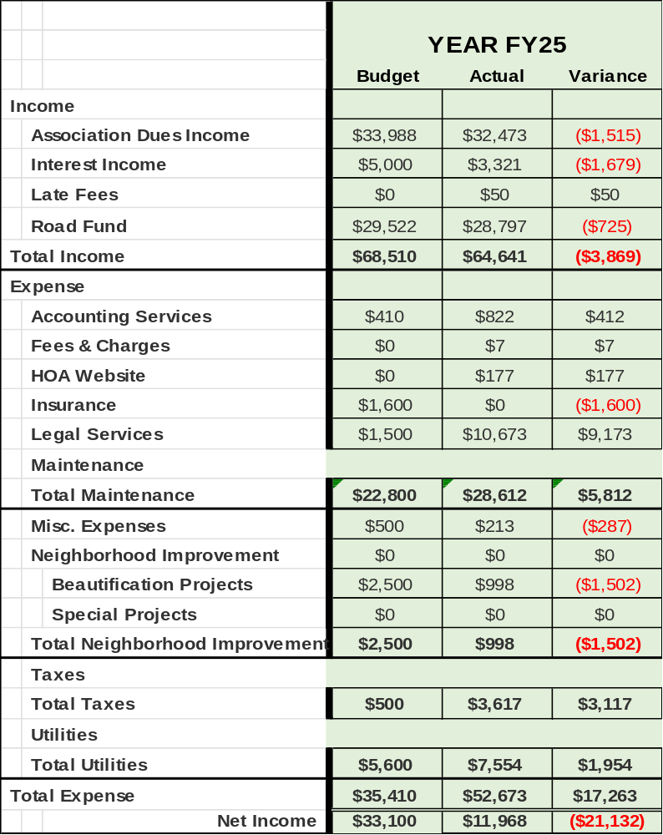
Appendix – A – FY25 P&L
2025 Full Year P&L

Slide 39
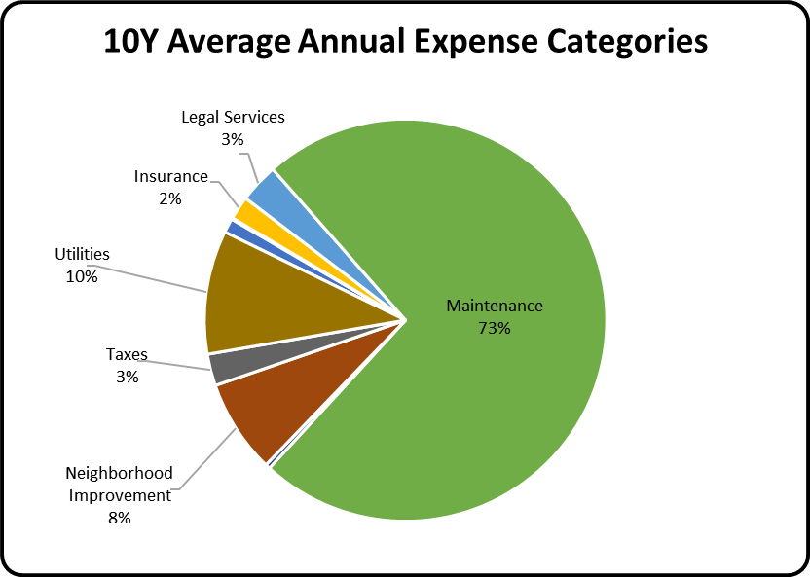
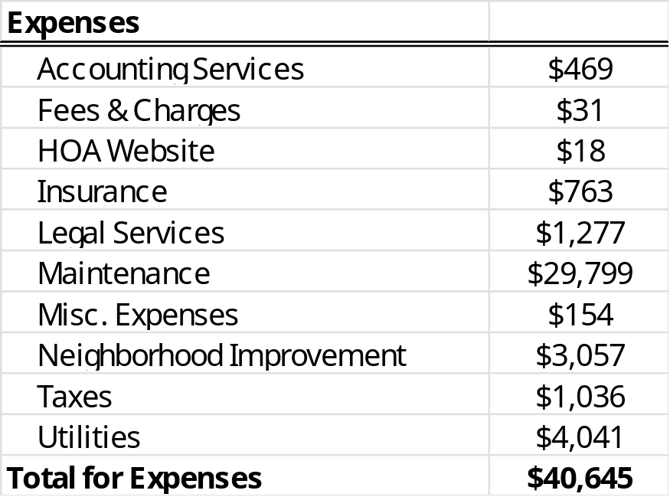
Appendix – B – 10Y Average Expenses
10Y Average Expense Categories

Slide 40
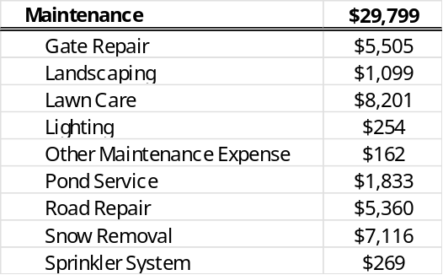
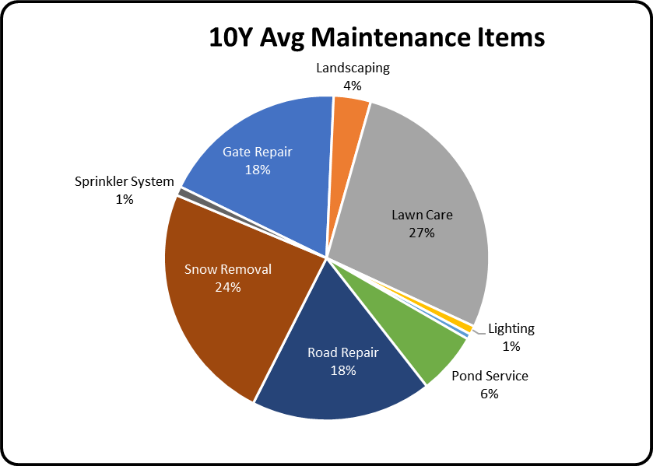
Appendix – B – Breakdown of Maintenance Expenses
10Y Average Expense Categories

Slide 41
Appendix – C – Road Fund Future
Assumptions:
Today’s cost = $400K (rounded up from actual expense, other estimates were higher)
Inflation = 2.5%
Annual Return on Road Fund (4%) (Includes increases and MM rates for Road Fund)

Slide 42
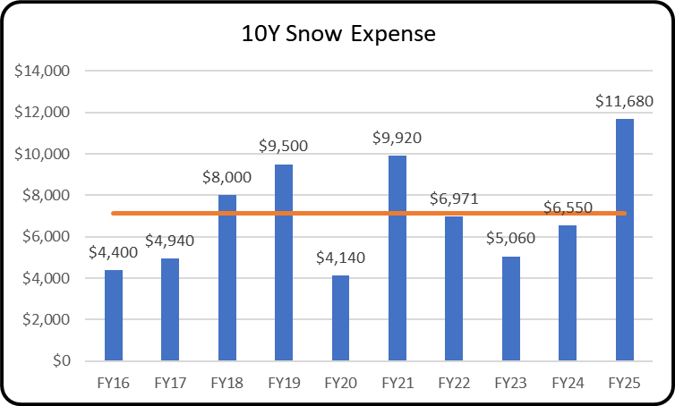
Appendix – D – 10Y Snow Expense
Snow Expenses for past 10Y
10Y Average = $7,116

Slide 43
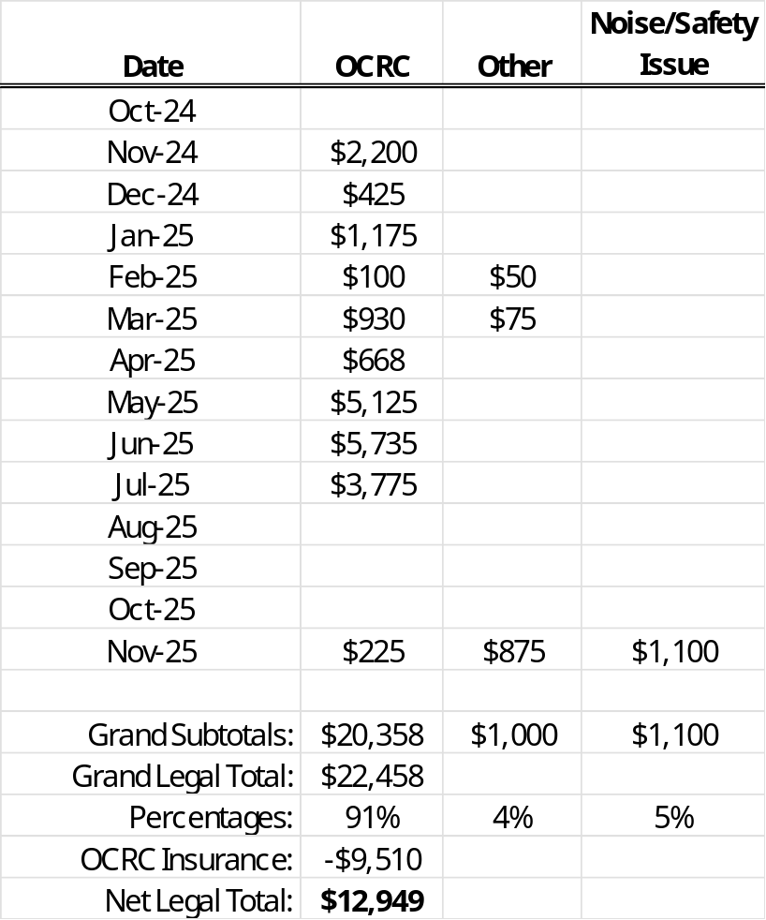
Appendix – E – Recent Legal Expenses
Legal Expenses for 14 months or so (needed to extend past FY25)
Notes
Totals below include expenses that were incurred in Aug/Sep FY25 but not paid until later. (Note: The Nov expenses are technically FY26 expenses and will show up in Q1 FY26)
The vast majority of legal expenses (91%) were the response and defense related to the legal complaint filed with the Ohio Civil Rights Commission.
The non-OCRC Total = $2,100, or $600 over our FY25 Budget of $1,500

Slide 44
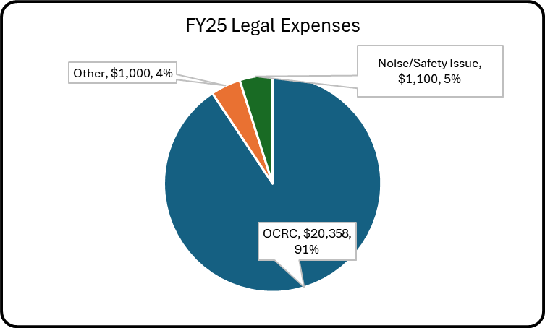
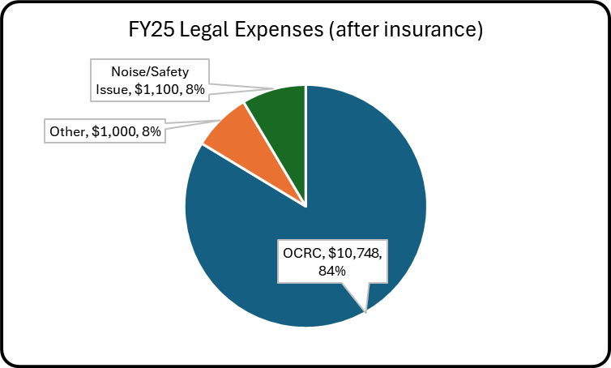
Appendix – E – Recent Legal Expenses (cont.)
Legal Expenses for 14 months or so (needed to extend past FY25)
Legal Expense Total without Insurance Reimbursement
Legal Expense Total with Insurance Reimbursement
Notes
“Noise/Safety” legal expenses are technically FY26 expenses and will show up in Q1 FY26.

Slide 45
Appendix – F – Insurance Expense
HOA Insurance Expense
FY25 HOA Insurance Expense – American Family Insurance: (Stopped providing HOA Ins in summer 2025)
  General Liability, Property, 3rd Party Liability, etc.: $1,576
FY26 HOA Insurance Expense – Cincinnati Insurance Company:
  General Liability, Property, 3rd Party Liability, etc.: $1,455
  Business Owners Policy: (BOP) $400 (Added new)
  Umbrella Policy: $800 (Added new)
  Total: $2,655
Notes
American Family ceased providing HOA insurance for all customers. (i.e., they exited the business)
After review of American Family policies, and some meetings with Cincinnati, we decided to add two (2) additional policies for the HOA and residents to provide better protection. (BOP and UMB)
Like for like policy was $121 cheaper.
With the addition of the two (2) new policies, insurance cost increased by $1,079, but has significantly better coverage.

Slide 46
Appendix – G – Sage Creek Website
Website
DEMO (www.sagecreekgalena.com)
Need someone to manage/update this site as an ongoing task. (Perhaps why a website was never created.)
Initial cost was $177 for 2 years but includes the one-time purchase of the name.
Ongoing costs should be approx. $20-$30 per year.
Transfer of the cost/maintenance/support of this website must occur, or the domain name will lapse in the March/April timeframe.

